Slide 1







CO1-AT2
Agile Sprint Planning and
User Story Workshop
Intelligent Electric Vehicle Charging Network Management System
Student: VIMALA K
Register Number: 192424276
Department: Artificial Intelligence and Data Science
College: Saveetha School of Engineering, SIMATS
Course: CSA1014 Software Engineering
Notes:
Good morning. This presentation walks through an Agile sprint-planning and user-story workshop for an Intelligent EV Charging Network Management System — from industry context and problem statement, through epics, user stories, backlog and sprint planning, to the expected outcomes.

Slide 2


Industry Context
Rapid EV growth — Electric-vehicle adoption is rising sharply, driven by cost, policy and sustainability goals.
Charging demand — Public and workplace charging demand is outpacing the rollout of new charging infrastructure.
Smart EV Charging Station
Long waiting times — Drivers queue at busy stations with no reliable way to know how long they will wait.
Connected EVs
AI prediction
Poor charger visibility — Real-time availability, location and status of chargers are rarely visible to drivers.
IoT sensors
Need for smart management — AI and IoT can monitor, predict and optimise charging across the whole network.
Clean energy
Notes:
Set the scene: EV adoption is accelerating, but charging infrastructure and its visibility lag behind. Drivers face long, unpredictable waits, and operators lack a unified view. That gap is what a smart, AI- and IoT-driven charging management system addresses.

Slide 3






Problem Statement
The system must address five interconnected capabilities, each feeding the next:
1
2
3
4
5
Real-time
Charger Monitoring
Waiting Time
Prediction
Energy
Consumption Tracking
Charger Health
Monitoring
Notification
System
Workflow
IoT sensors read charger state
Data streamed to cloud platform
AI predicts wait & flags faults
Drivers & staff notified in real time
Notes:
The problem breaks into five capabilities shown as a pipeline: monitoring feeds prediction, tracking and health checks, and everything surfaces through notifications. The workflow ribbon shows the data path from IoT sensors to real-time alerts.

Slide 4






Project Vision & Objectives
Vision To deliver an intelligent, connected EV-charging network that gives drivers real-time visibility, minimises waiting, and helps operators optimise energy and maintenance across every station.
Monitor charging stations
Predict waiting time
Optimise charger allocation
Track live status, availability and usage of every charger in the network.
Use AI to forecast queue and charge-completion times for each station.
Guide drivers to the best available charger to balance network load.
Generate energy reports
Improve customer satisfaction
Smart, sustainable charging
Produce consumption and efficiency reports for administrators.
Reduce uncertainty and waiting to deliver a smoother charging experience.
Every objective feeds one goal: an efficient, greener charging ecosystem.
Notes:
State the vision, then the five objectives as a SmartArt-style icon grid. The sixth tile ties them together: each objective serves the single goal of a smart, sustainable charging ecosystem.

Slide 5






Stakeholder Analysis
Stakeholder | Role | Responsibilities | Challenges
EV Driver | End user | Find, reserve and use chargers; pay for sessions. | Long waits and uncertain charger availability.
Station Operator | Service provider | Run stations; ensure chargers are online and available. | Balancing demand and uptime across sites.
Administrator | System manager | Oversee network, users and energy reports. | Turning raw data into actionable decisions.
Maintenance Team | Support | Diagnose and repair faulty chargers quickly. | Detecting faults early to cut downtime.
Energy Provider | Supplier | Supply and bill electricity to the network. | Managing peak load and grid stability.
Relationships
Driver
Charging
Platform
Operator
Energy
Admin
Maint.
Notes:
Five stakeholders, each with a role, responsibilities and a core challenge. The hub-and-spoke diagram shows that all of them connect through one central charging platform — which is what the system provides.

Slide 6


Epics — Agile Roadmap
User Management
Charging Session Management
Energy Reporting
Maintenance Management
Registration, login, profiles and roles.
Start, stop and reserve sessions.
Consumption and efficiency analytics.
Fault detection and repair tracking.
1
2
3
4
5
6
7
Charging Station Monitoring
Waiting Time Prediction
Notification System
Live status and availability of chargers.
AI forecasts of queue and charge times.
Alerts for availability and faults.
Notes:
Seven epics laid out as an Agile roadmap on a timeline spine. Each epic is a large body of work that will later be broken into user stories; the numbering suggests a rough delivery order across sprints.

Slide 7



User Stories
As a EV Driver
As a EV Driver
As a EV Driver
I want to register
I want to view nearby charging stations
I want to reserve a charger
so that I can access charging services.
so that I can choose the nearest charger.
so that I don't have to wait.
As a Administrator
As a Maintenance Engineer
I want to view energy reports
I want to receive charger fault alerts
so that I can monitor electricity usage.
so that I can repair faulty chargers quickly.
Notes:
User stories in the standard Agile format — As a [role], I want [goal], so that [benefit]. Presented as story cards, colour-coded and grouped by driver, administrator and maintenance roles.

Slide 8

Acceptance Criteria
Given–When–Then — Given a context, When an action occurs, Then the system produces a defined, testable outcome.
Scenario | Given | When | Then
Registration | A new user on the signup page | they submit valid details | the account is created and confirmed.
Login | A registered user | they enter correct credentials | they are granted access to the dashboard.
Charger Availability | A driver viewing the map | they open a station | live availability of each charger is shown.
Reservation | An available charger | the driver reserves it | the charger is held for that driver.
Waiting Time Prediction | A busy station | the driver requests an estimate | a predicted waiting time is displayed.
Notes:
Acceptance criteria make each story testable. Explain the Given–When–Then structure, then read one row — registration is a good example — to show how it converts a story into a pass/fail check for the sprint review.

Slide 9
Product Backlog
Priority | Epic | User Story | Business Value | Story Points
High | User Management | Register and log in to the platform | Essential access to all services | 5
High | Station Monitoring | View live charger availability | Core value — drivers find chargers | 5
High | Session Management | Reserve a charger in advance | Directly cuts waiting time | 8
Medium | Waiting Time Prediction | See predicted waiting time | Improves planning and trust | 8
Medium | Notification System | Get availability and fault alerts | Keeps users and staff informed | 5
Low | Energy Reporting | Generate energy usage reports | Supports admin optimisation | 5
Low | Maintenance Management | Track and resolve charger faults | Reduces long-term downtime | 5
Priority:
High
Medium
Low
Notes:
The product backlog, ordered by priority and colour-coded — red high, orange medium, green low. High-value access and monitoring features sit at the top; reporting and maintenance are lower priority. Story points hint at relative effort.

Slide 10
Sprint Backlog — Scrum Board
Sprint Duration: 2 Weeks Sprint Goal: Develop the core charging management features.
To Do
In Progress
Done
Station Monitoring
Login
Registration
Core feature
Core feature
Core feature
Charger Availability
Core feature
Notes:
The sprint backlog on a Scrum task board. Four core tasks move across To Do, In Progress and Done. This is a snapshot mid-sprint: registration is complete, login is under way, and monitoring and availability are queued.

Slide 11
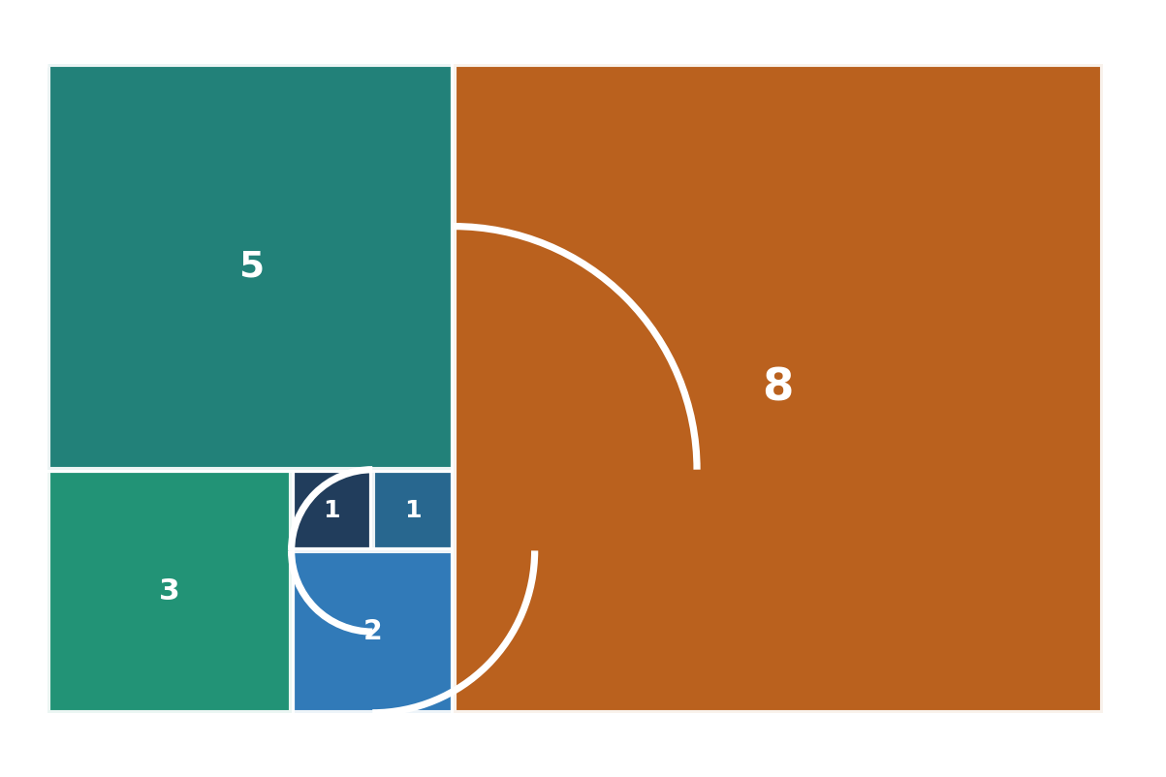
Story Point Estimation
Fibonacci estimation — story points grow non-linearly (1, 2, 3, 5, 8, 13, 21…) so larger, riskier stories are separated clearly from small ones.
Fibonacci Sequence
User Story | Points | Justification
Registration | 3 | Standard form and validation.
Login | 2 | Simple, well-understood auth.
Station Monitoring | 5 | Live data integration needed.
Charger Availability | 5 | Real-time status per charger.
Reservation | 8 | Concurrency and hold logic.
Waiting Time Prediction | 8 | AI model and data pipeline.
Notifications | 5 | Event triggers across channels.
1
2
3
5
8
13
Each number is the sum of the two before it — gaps widen as uncertainty grows.
Notes:
Explain why Agile teams estimate in Fibonacci points rather than hours: the widening gaps force a clear decision between, say, a 5 and an 8, capturing rising uncertainty. Walk the table — reservation and prediction are the heaviest at 8.

Slide 12





Sprint Goal & Deliverables
Sprint Goal Develop user authentication and real-time charger monitoring.
Registration Module
Login Module
Charging Dashboard
Charger Availability
Database Integration
Basic UI
Unit Testing
Milestone Timeline — 2-week sprint
Day 1–2
Day 3–5
Day 6–9
Day 10–12
Day 13–14
Setup & DB
Auth modules
Monitoring
UI & integrate
Test & review
Notes:
The sprint goal narrows to authentication plus real-time monitoring. Seven concrete deliverables are shown as an icon grid, and the milestone timeline sketches how the two-week sprint is phased from setup to test-and-review.

Slide 13

Agile Workflow
Requirements
Product Backlog
Sprint Planning
1
2
3
Testing
Development
Sprint Backlog
6
5
4
Sprint Review
Sprint Retrospective
Product Increment
7
8
9
Notes:
The full Scrum workflow as a serpentine flowchart: requirements become a backlog, sprint planning produces a sprint backlog, development and testing yield a review and retrospective, and the loop delivers a product increment — then repeats.

Slide 14

Expected Outcomes
Reduced waiting time
Better charger utilisation
Improved energy management
Reservations and predictions cut queueing at busy stations.
Smart allocation balances load across the network.
Consumption tracking and reports optimise electricity use.
Higher customer satisfaction
Efficient maintenance
Smart charging ecosystem
Reliable visibility and shorter waits improve the experience.
Fault alerts enable faster repair and less downtime.
A connected, data-driven, sustainable charging network.
Notes:
Six expected outcomes in an infographic grid. The through-line: less waiting, better utilisation and energy use, happier customers, faster maintenance — all adding up to a smart, sustainable charging ecosystem.

Slide 15


Conclusion
Agile improves project management by delivering value in short, adaptive cycles.
Sprint planning helps prioritise the features that matter most, first.
User stories keep the team focused on real customer needs and outcomes.
Smart EV charging reduces waiting time and optimises energy usage across the network.
Thank You
Notes:
Summarise the four takeaways: Agile improves management, sprint planning prioritises, user stories keep customer focus, and the smart charging system cuts waiting and optimises energy. Thank the panel and invite questions.

